Slide 1
Automated Hyperspectral Pyrometry of Floating Zone Growths
Naman Parikh¹, David Elbert², Tyrel McQueen³
¹Department of Physics, Carnegie Mellon University
²Hopkins Extreme Materials Institute
³Department of Chemistry, Johns Hopkins University

Slide 2
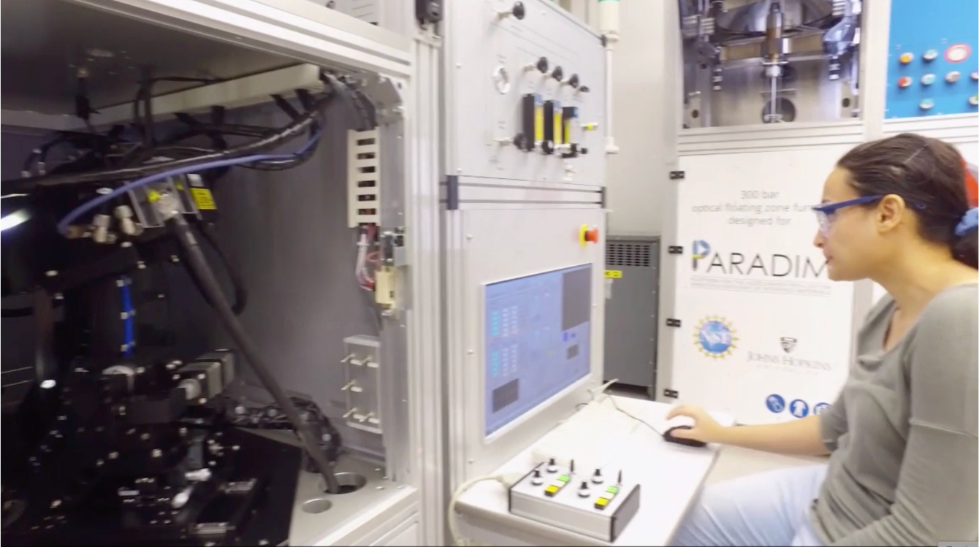
Laser Diode Floating Zone
Notes:
I worked on studying floating zone growths using the Laser Diode Floating Zone furnace that we have. Before I talk about what I did, I’ll give you a brief overview of how floating zone growths work.

Slide 3
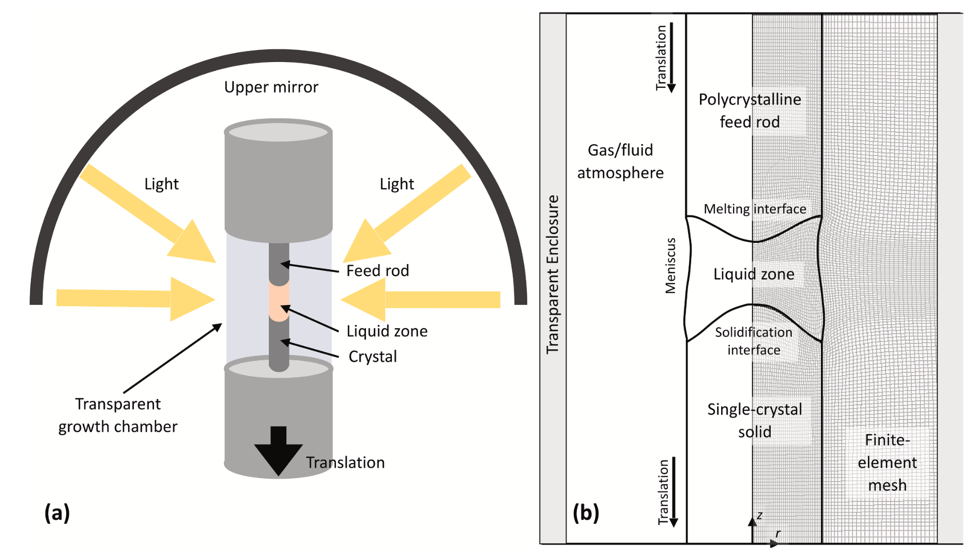
Scott S. Dossa, Jeffrey J. Derby
https://doi.org/10.1016/j.jcrysgro.2022.126723
Notes:
We start with two rods mounted in the furnace vertically pointing at each other. The bottom rod is the crystalline rod while the top is the feed rod. Some source of heat points towards the center, melting the tips of the rods to create a liquid floating zone. The rods are then pulled apart and a crystal grows out of the liquid zone.

Slide 4
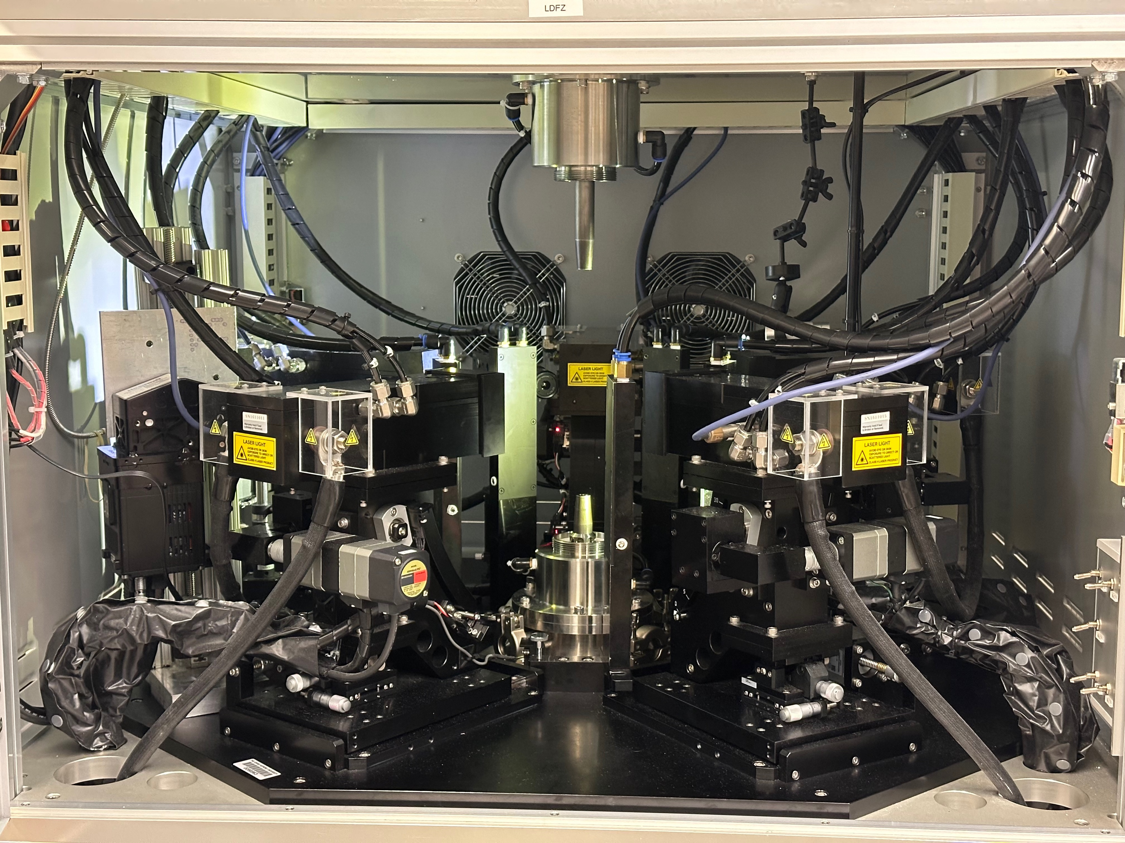
Notes:
This particular furnace uses lasers to heat the rods, and there are 5 set around the center. So, how can we go about studying how floating zone growths work and how to design growths? One big picture approach to think about is to think about the development of a digital twin for floating zone growths.

Slide 5
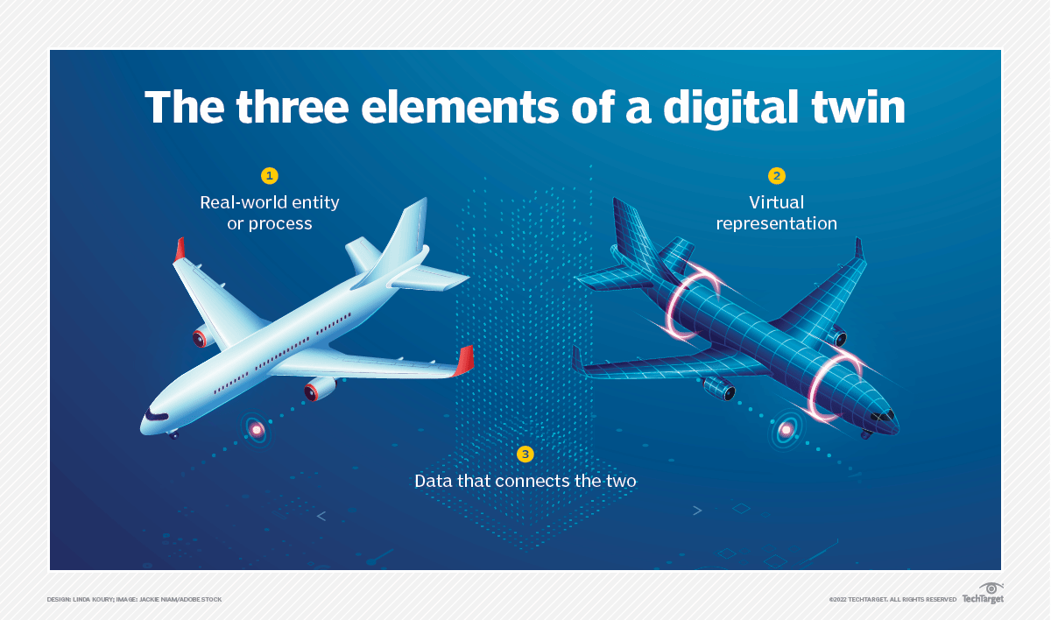
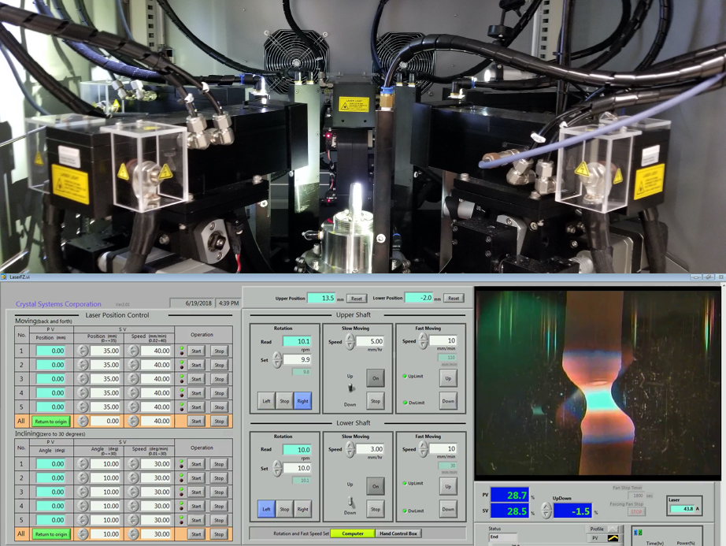
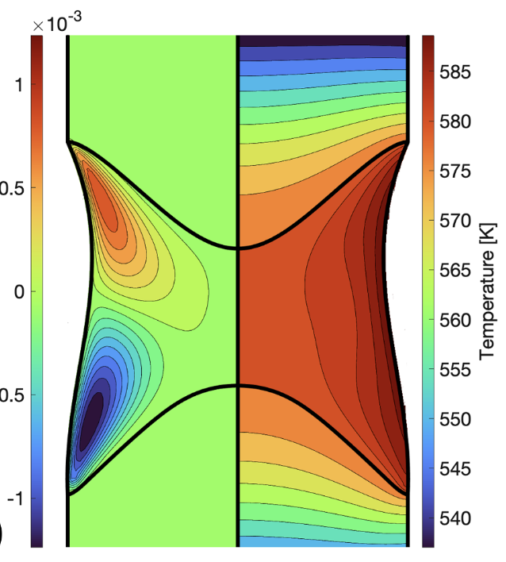
Notes:
What is a digital twin? It can take a lot of forms but generally it’s the idea of having a digital representation of some physical object or process. In our case, the physical twin includes the furnace growths, the materials, and the controls of the furnace like the rotation speed and pull rate of the rods. The digital twin is some manner of computational model that simulates the growth happening within the furnace. We would want this model to be able to simulate the evolution of the growth over time, how the growth reacts to changes to the furnace controls, and the crystal structure and properties resulting from the growth. So, let’s talk about the current state of the digital models and what we can do to improve them.

Slide 6
Physical
Digital
Data
?
Scott S. Dossa, Jeffrey J. Derby
https://doi.org/10.1016/j.jcrysgro.2022.126723
Notes:
So, what are these 3 elements for floating zone growths? The physical aspect would be the growth itself, the process of the growth and the underlying physics that governs the growth. Also an important part of the physical element is the controls of the furnace. The experimenter can change things like the rotation speed and pull rate, and these affect the growth. The last physical element is the crystal the is made at the end. Whether it’s a single or multiple crystal, it’s structure, and it’s properties. The digital twin that is being made in other work is computational models and simulations of the growths. This includes finite element models to track the thermal distribution and fluid flow during a growth. Currently, these models have had some success in different ways of simulating the molten zone and solid-liquid interface, but they are informed only by physics theory and not actual growth data, and they are not validated against physical growths. So, they are fundamentally disconnected because of the lack of data.

Slide 7
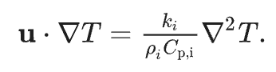
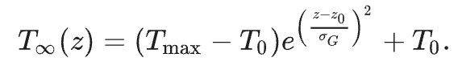
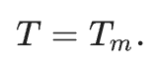
Modeling – NaNO₃
Scott S. Dossa, Jeffrey J. Derby
https://doi.org/10.1016/j.jcrysgro.2022.126723
7
Notes:
What makes these models difficult to use because the inputs for the models are not the same as the inputs for a physical growth. For a physical growth, we have things like the laser power and pull rate, but the input for the models is things like the temperature field, which we don’t know how to measure for a physical growth. IF I WANT TO USE THE MODEL TO INFORM MY GROWTH, I need some way to measure the temperature distribution so I can then input it into the model. Additionally, the model doesn’t know how to determine how the heat will flow as the samples are heated up during the growth. Temperature is missing as data for the physical growths and because of this is missing from the model’s ability to predict. So, data that would be useful in developing a digital twin is the temperature distributions of growths.

Slide 8
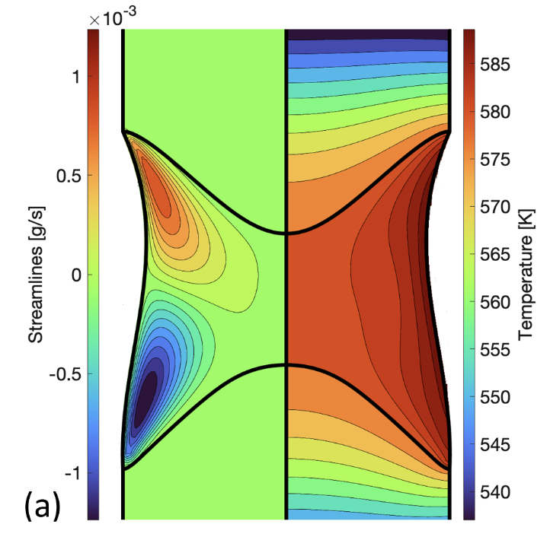
Modeling – NaNO₃
Scott S. Dossa, Jeffrey J. Derby
https://doi.org/10.1016/j.jcrysgro.2022.126723
8
Notes:
The basics of this is a finite element model of the two rods and the liquid zone between them. In particular, the model starts with some materials and temperature distribution and then simulates the fluid and heat flow. So, let’s take a look at what these models have and are missing from the goal of a digital twin.

Slide 9
Digital Twins
“Set of virtual information constructs that mimics the … system”
“Has a predictive capability”
“Informs decisions that realize value”
“Dynamically updated with data from it’s physical twin”
National Academies of Sciences, Engineering, and Medicine
https://doi.org/10.17226/26894

Slide 10
Digital Twins
“Set of virtual information constructs that mimics the … system”
“Has a predictive capability”
“Dynamically updated with data from it’s physical twin”
?
?
National Academies of Sciences, Engineering, and Medicine
https://doi.org/10.17226/26894
Notes:
Firstly, we have a set of virtual constructs that mimic the system, which is what the simulation is. It has some predictive capability in returning temperature distribution and fluid flows, but it isn’t at the point of predicting the effects of the furnace controls or the crystal structure and properties. These models are built only on physics theory, but that isn’t enough for those other 2 parts. For that, the model needs to update and improve based on experimental data from physical growths. The models simulate temperature distributions, so what we want to do is collect some temperature distribution data from experiments to inform and validate the models.

Slide 11
Research Question
How can we collect temperature data from lab growths?

Slide 12
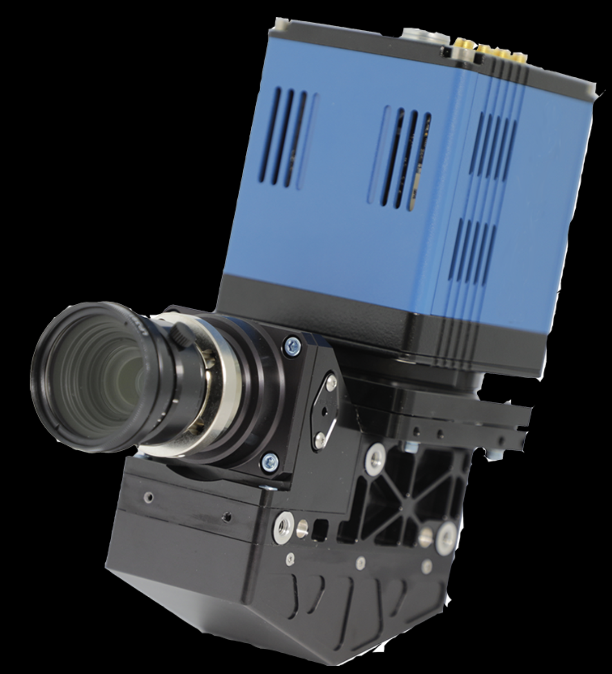
Hyperspectral Camera
Notes:
With a hyperspectral camera, we can measure a full emission spectrum for each pixel. From there, we’ll have to do some analysis to figure out how to get temperature.

Slide 13
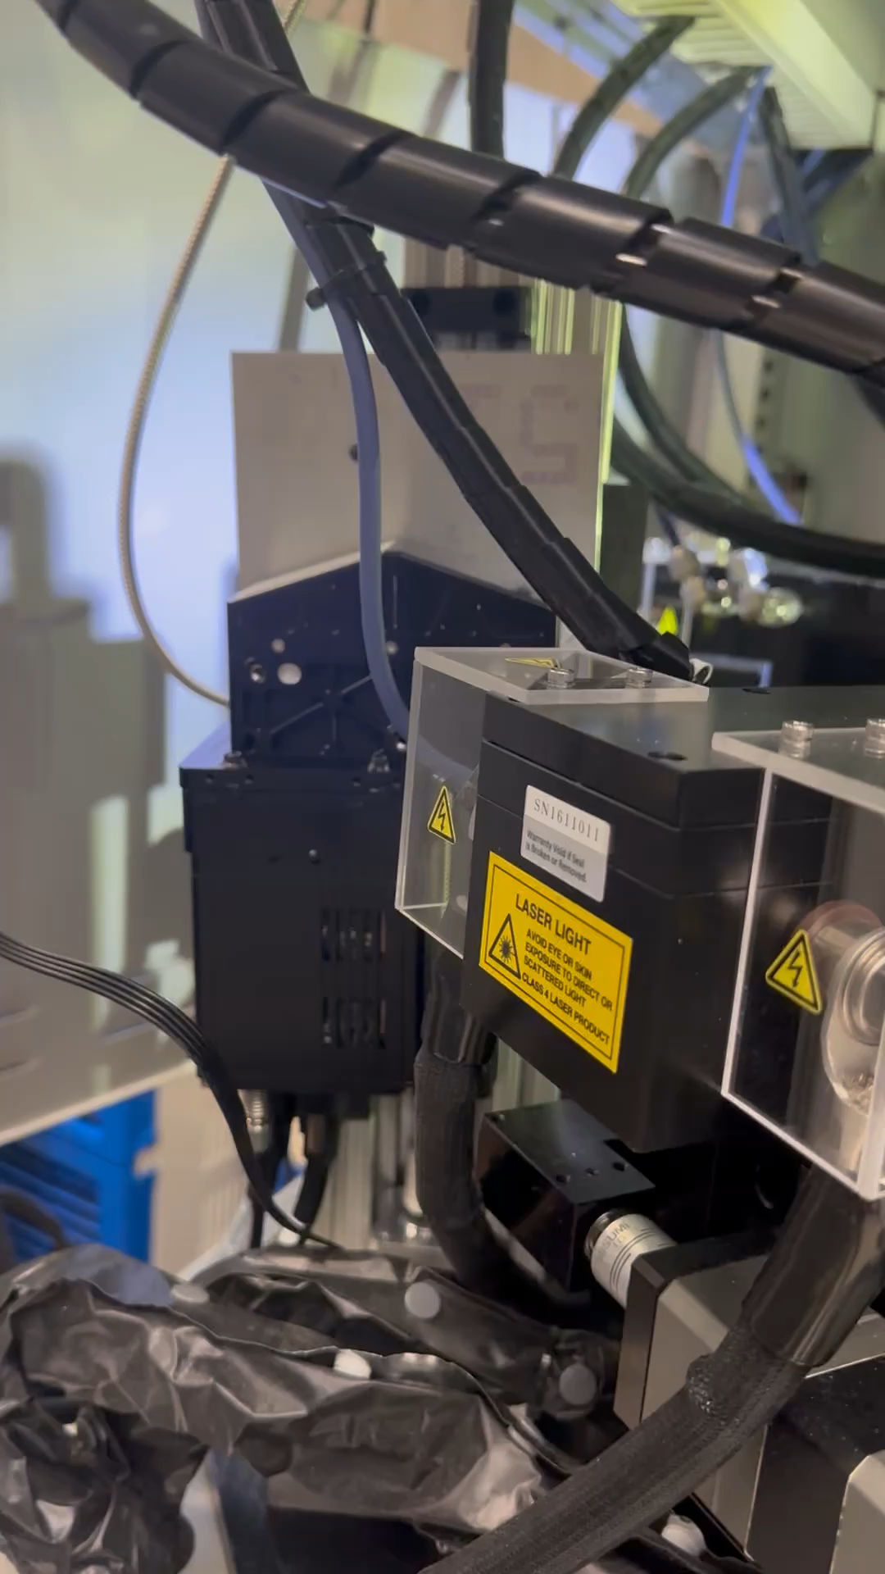
What are the steps?
Collect data
Analyze the data automatically
Notes:
So, first and foremost is to get the camera set up in the furnace to be able to collect data. You can see the camera mounted there alongside the laser. Another detail is that the camera captures a line rather than a 2-D image, so it needs to scan up and down to capture a full image. The next thing is to analyze the data, but before I get into the details of how to do that, I want to talk about how exactly we set it up. We want to be able to collect a lot of data, so we want to be more efficient than manually capturing and analyzing each individual image separately. We also want the models to ultimately update automatically as new data comes in, so we should start laying the groundwork for that automation now. So, here’s how we do that.

Slide 14
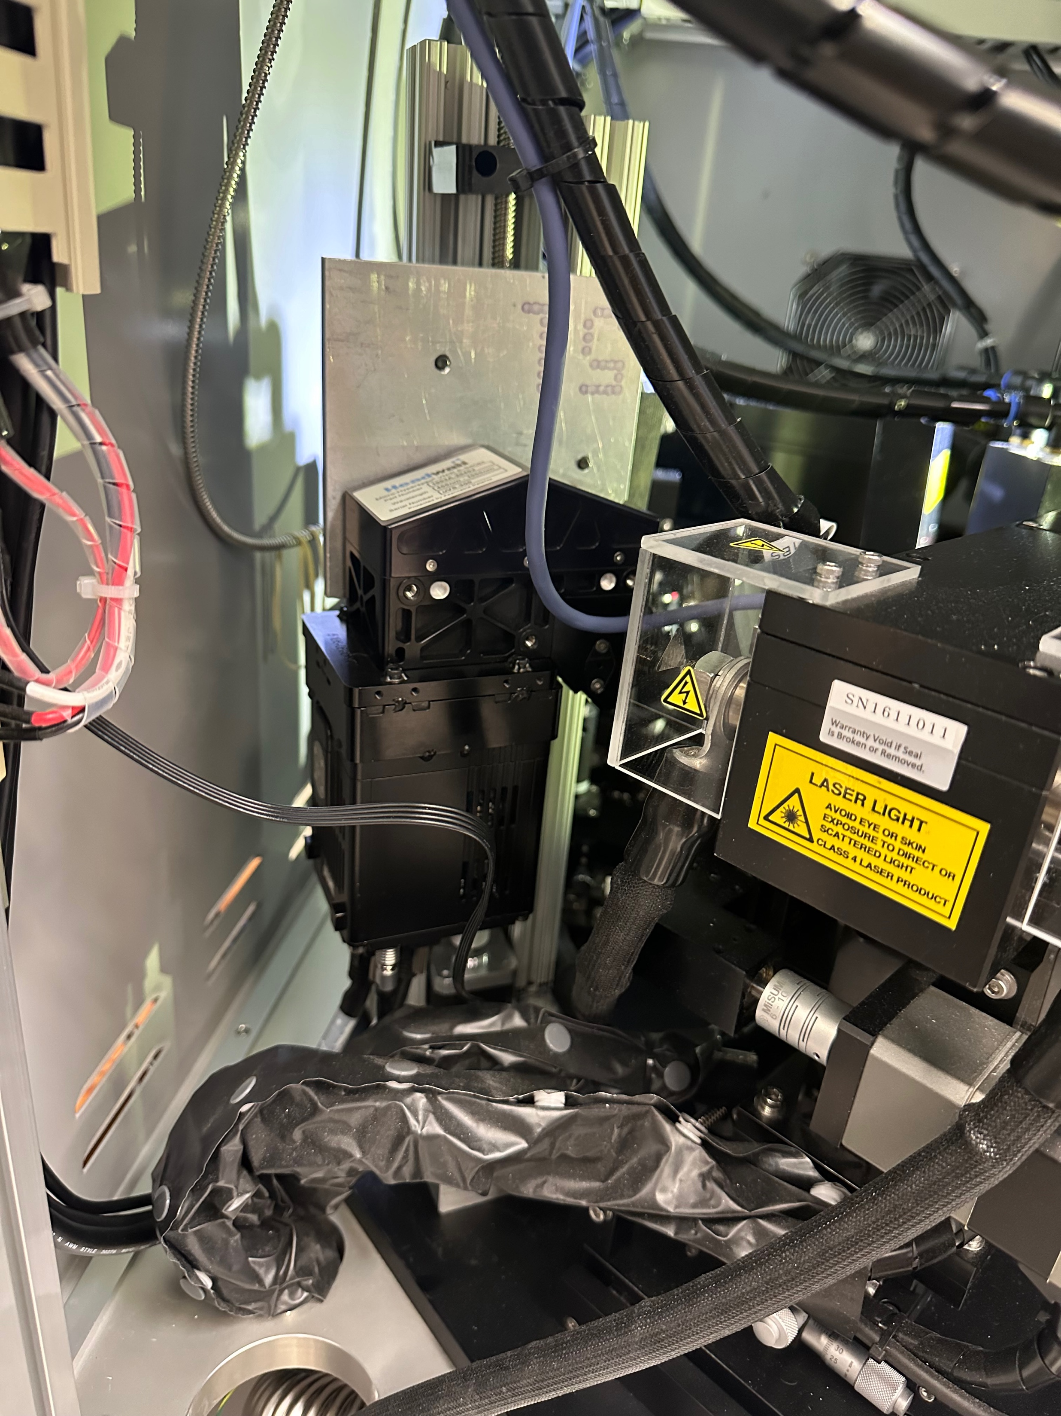

Slide 15
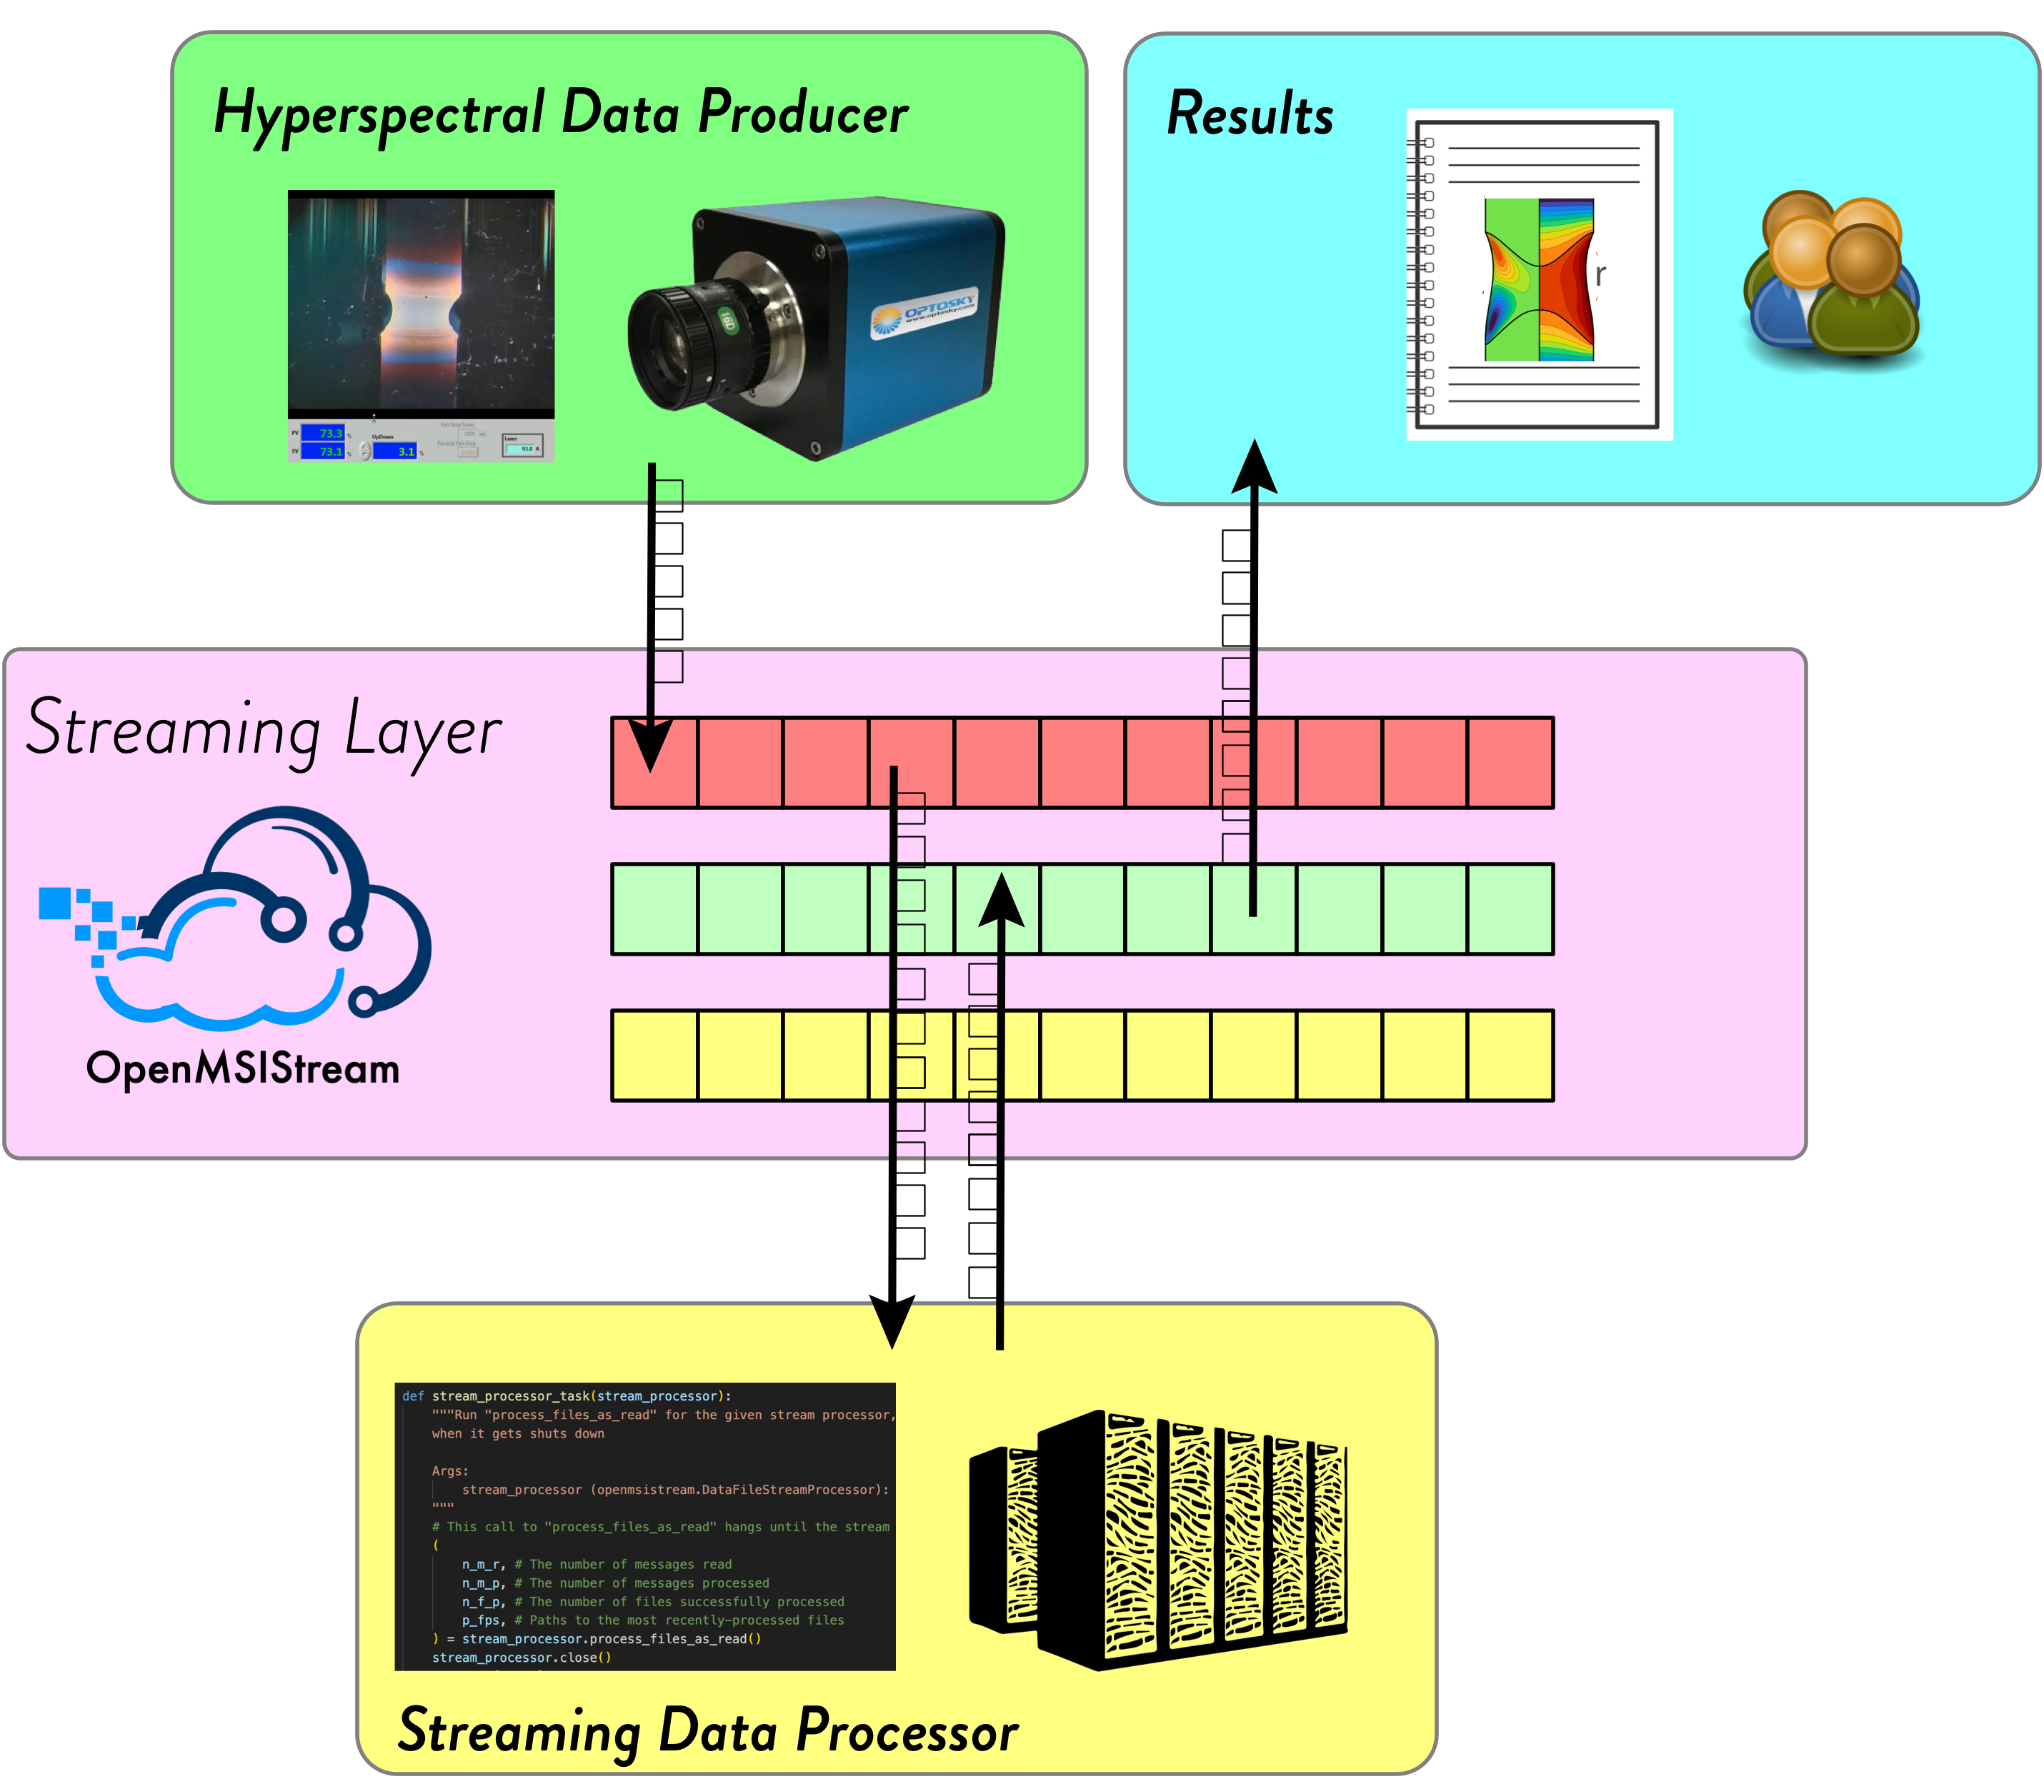
Notes:
We use something called data streaming. When the image is captured by the camera, it is automatically streamed out to a third party server. From there, the data is consumed by a stream processor that’s hosted on one of our paradim servers. There, the raw data is both stored in a database and also analyzed. The resulting temperature distribution is then streamed back out to the third party and then back to the lab so that the people doing the growth can see the results in real time.

Slide 16
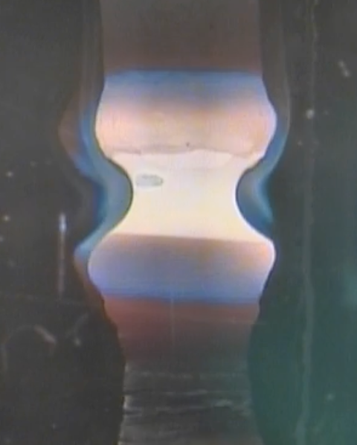
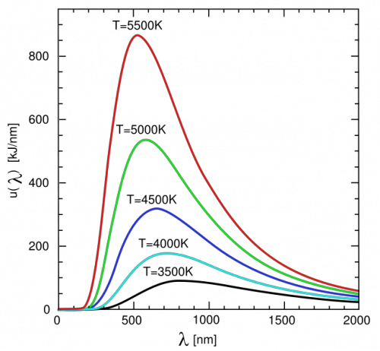
Pyrometry
Blackbody
Notes:
So, how do we actually get temperature from hyperspectral data? The key observation is that a hot glowing material is a blackbody, and blackbody spectra are completely unique depending on the temperature of the object. It will be a little challenging because the camera only captures a limited range, but we’ll see how it goes.

Slide 17
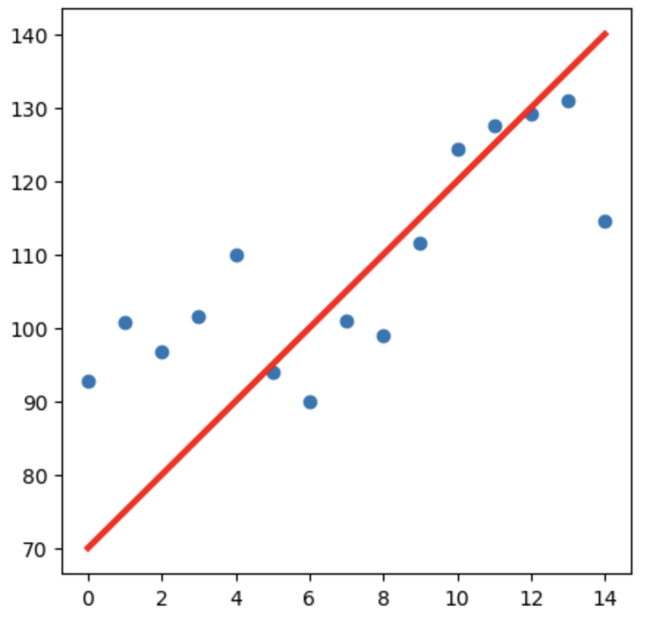
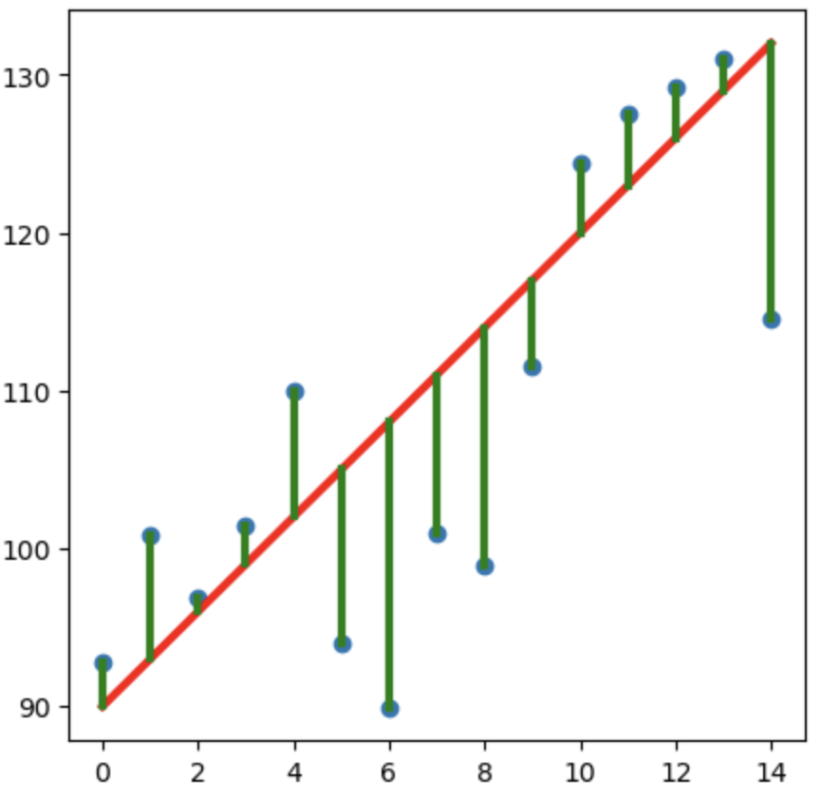
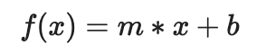
Least Squares Regression
Model Function
Guess Parameters
Minimize Residuals
Parameters
Notes:
To do this, we can use least squares regression. With this regression method, we start by providing a model function, which we know for blackbody radiation. The regression than optimizes parameters of the function, which will include temperature that we want. We then guess some parameters, getting a bad fit, but the residuals are minimized and parameters optimized to get the best fit. There’s lots of code already written to do the last part, so what we need to do for this specific usage is figure out what the model function should be.

Slide 18
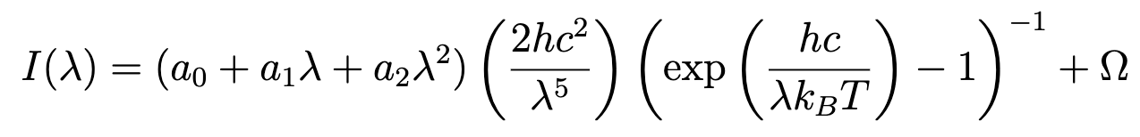
Blackbody Model Function
Emissivity
Stray Light Offset
Parameters
Notes:
There’s 3 parts here. The middle is the actual core of the blackbody shape that should look familiar. The piece in front is an approximation of emissivity. Emissivity changes depending on the materials we use and can also vary over wavelength, so we use a quadratic expansion to model that dependence. Finally, there’s a constant offset at the end. This term improves the regression by adding some flexibility. Like any spectrum, blackbody radiation always goes to 0 as the wavelength goes to 0. However, forcing the fitting to stick to this turns out to cause some aggressive overfitting. The spectrum could be shifted up by stray light in the background or mistakes in correcting the spectrum against black and white references, so it helps to add this term to account for those things. With these added pieces, we have added parameters to optimize during the regression alongside temperature.

Slide 19
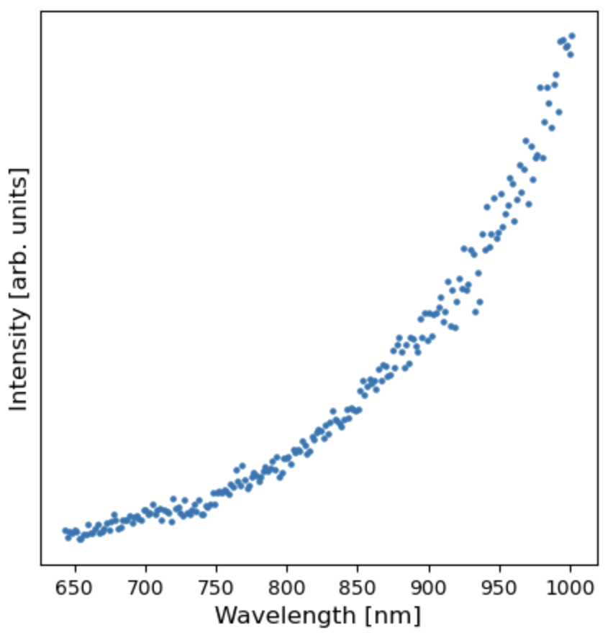
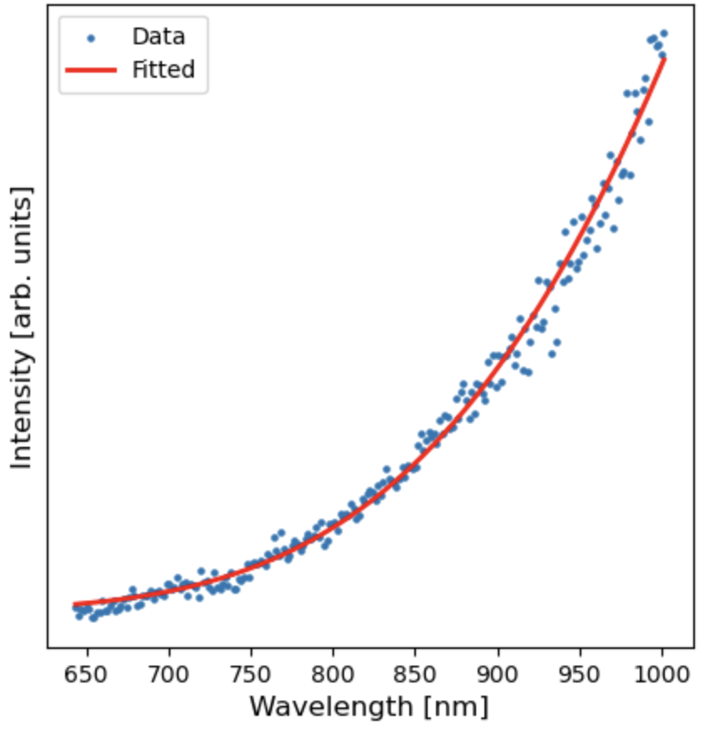
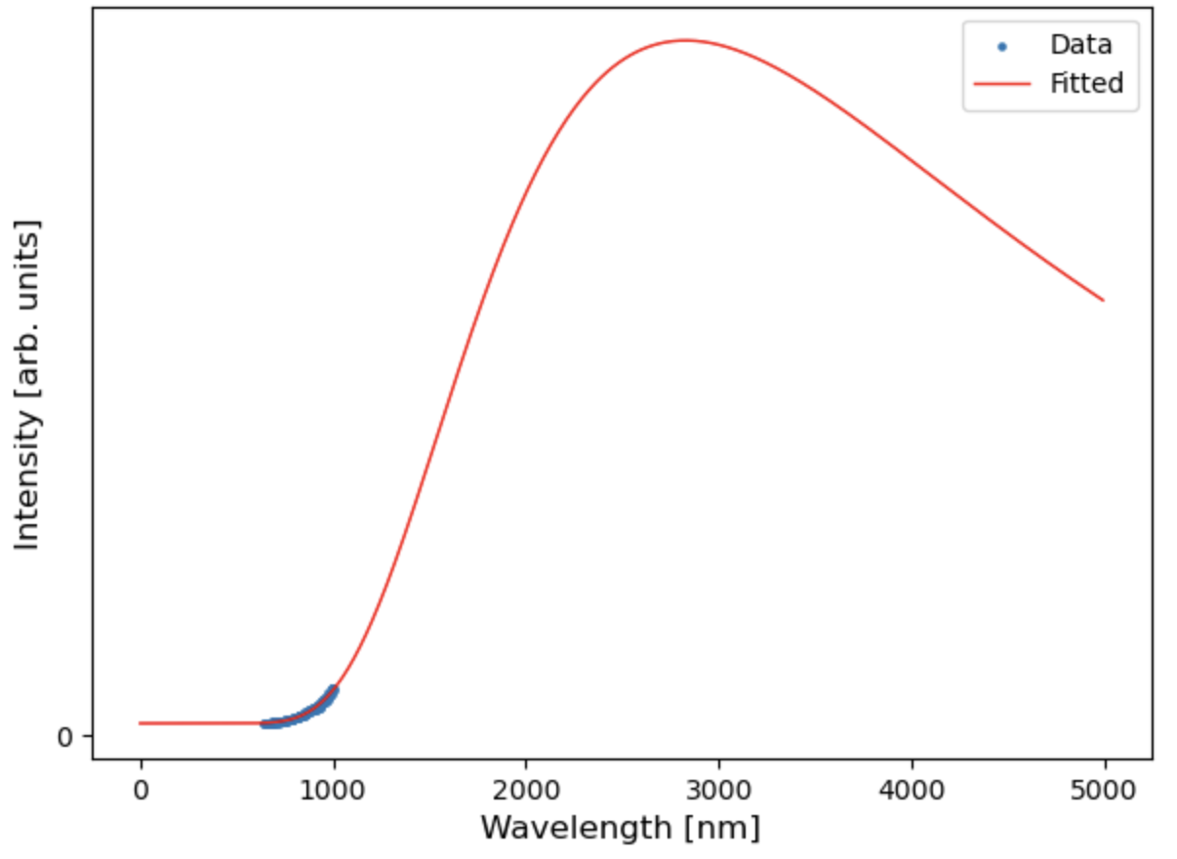
Data
Fitted with T=1298 K
Full Spectrum
Notes:
So, let’s take a look at how this works. Here’s a spectrum that we measured during testing. You’ll notice that it doesn’t quite look like a blackbody spectrum, and that’s because of the limited wavelength range that I mentioned. Nevertheless, if we run the regression, we get a nice looking fit and a reasonable temperature value of about 1000 C. We can also zoom out to see that we actually have been looking at a very small part of the blackbody spectrum, but the regression is still successful.

Slide 20
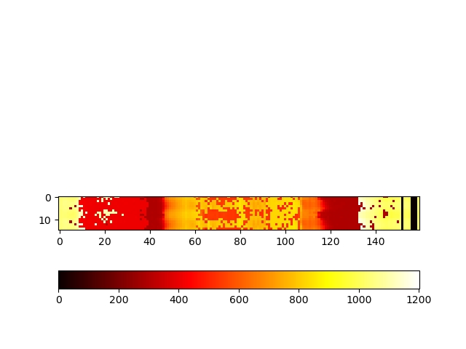
Into the furnace
Kelvin
20
Notes:
So, taking this analysis into the furnace, here we have an image from a growth. There’s not much to see in the png because this growth was too dark to see much. We can fix that by increasing the exposure time, but it turns out that we are still able to get temperature well with a low exposure, so I stuck with that. Also, because we set up all the automation, this is super easy to run. I clicked capture image, waited, and got back this heatmap. **Talk about what this is looking at, what we see**

Slide 21
What’s next?
Optimizing the analysis
Collect tons of data
Validate and inform models
Notes:
Optimizations include performance improvement and potentially needing to reduce sensitivity to atomic emission spikes

Slide 22
Physical
Digital
Autonomous Experimentation
Data

Slide 23
Physical
Digital
Measurement
Predictions
Data
Promising growths
Model validation and updating
Notes:
Finally, I want to take a step back and talk about how this fits into the bigger picture that I talked about at the beginning. This data is measured from physical experiments, and it can now be used to inform and validate the digital models that we talked about. Going the other way, we now speak a common data language so we can take the predictions the models dive and use them to inform future growths. Those growths in turn create more data, and the cycle of experimentation and improvement continues.

Slide 24
Physical
Digital
Data
“Dynamically updated with data from it’s physical twin”
“Bidirectional interaction”
“Informs decisions that provide value”
Notes:
This hits on the last

Slide 25
Acknowledgements
Physical
Digital
Data
Evan Crites (McQueen Lab, PARADIM)
Maggie Eminizer (IDIES)
NSF Awards #2039380 (PARADIM) and #2129051 (VariMat)

Slide 26
Extra Slides – Other Carbon Rod Spectra

Slide 27
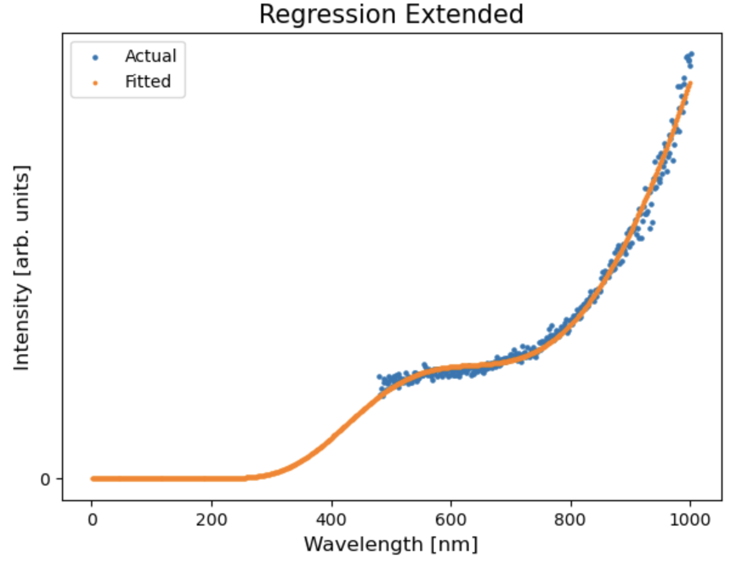
Overfitted
27

Slide 28
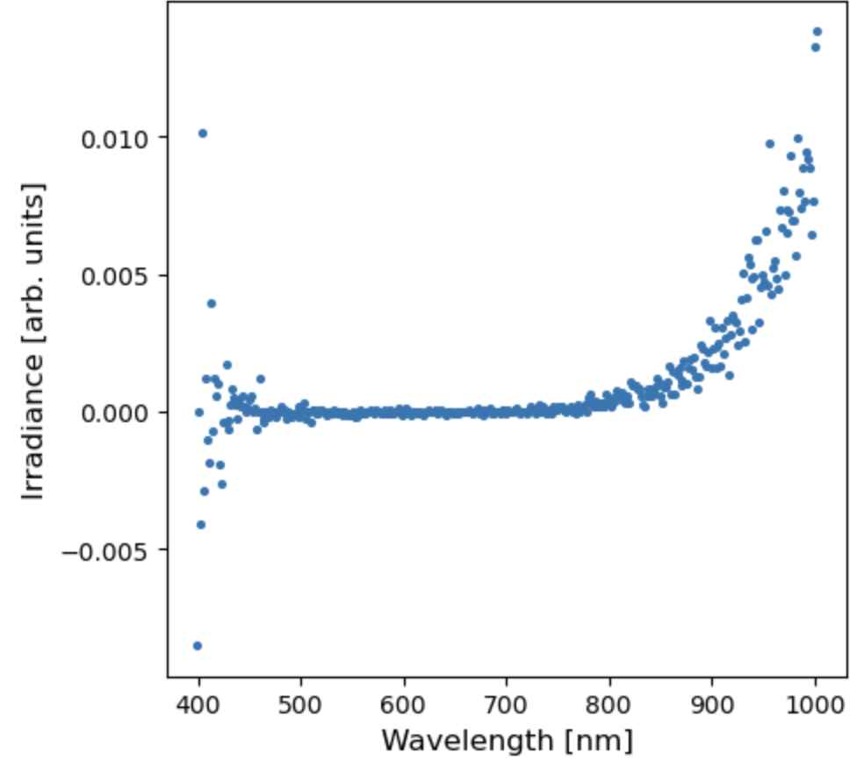
Carbon Rod Corrected

Slide 29
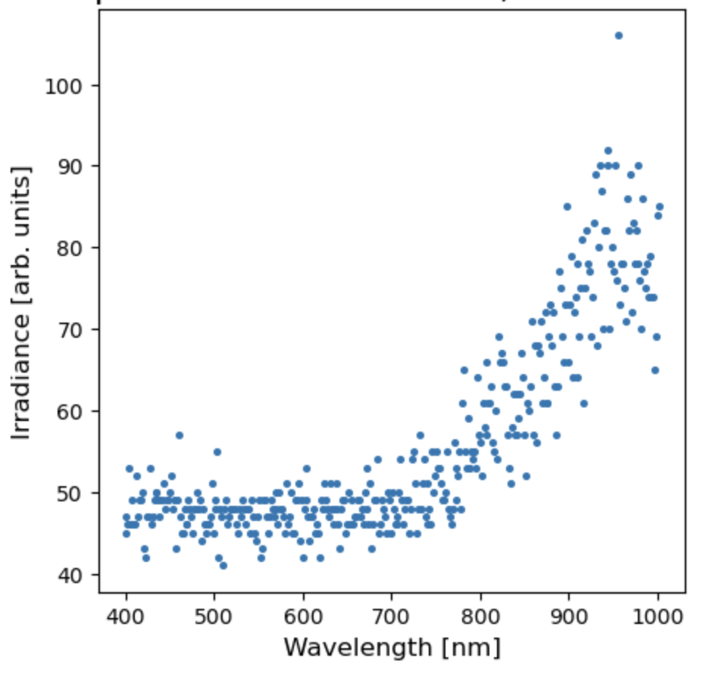
Carbon Rod Uncorrected

Slide 30
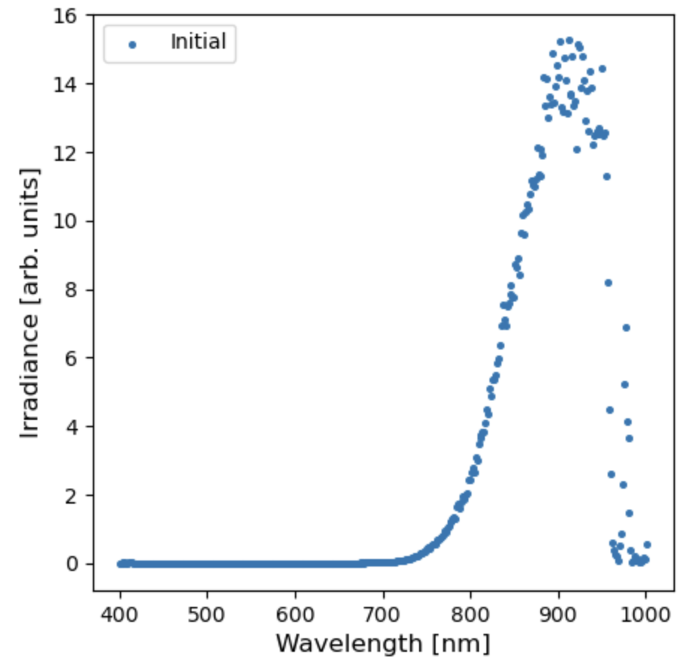
Notch Filter Dip

Slide 31
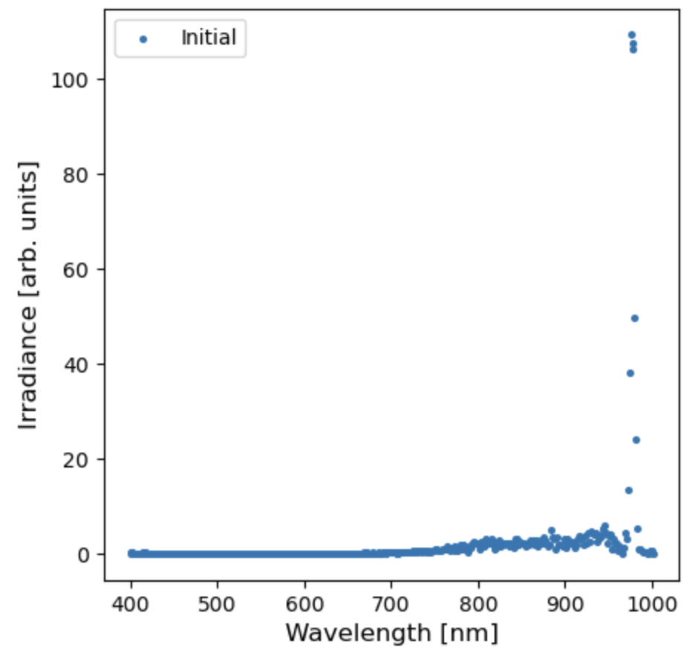
Laser Light Spike

Slide 32
Extra Slides – Camera Motion

Slide 33
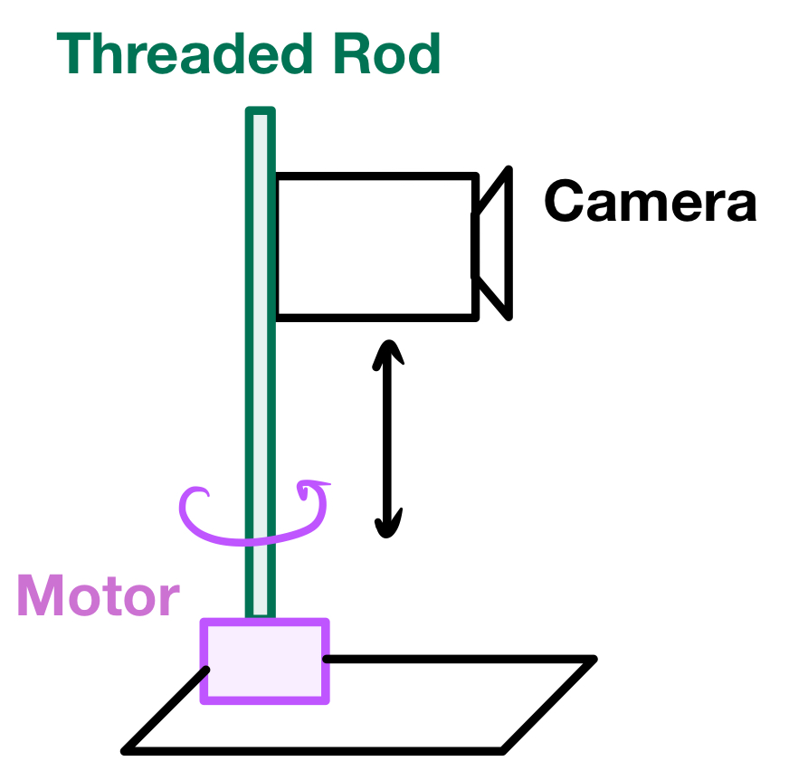
Notes:
How do we make it scan?

Slide 34
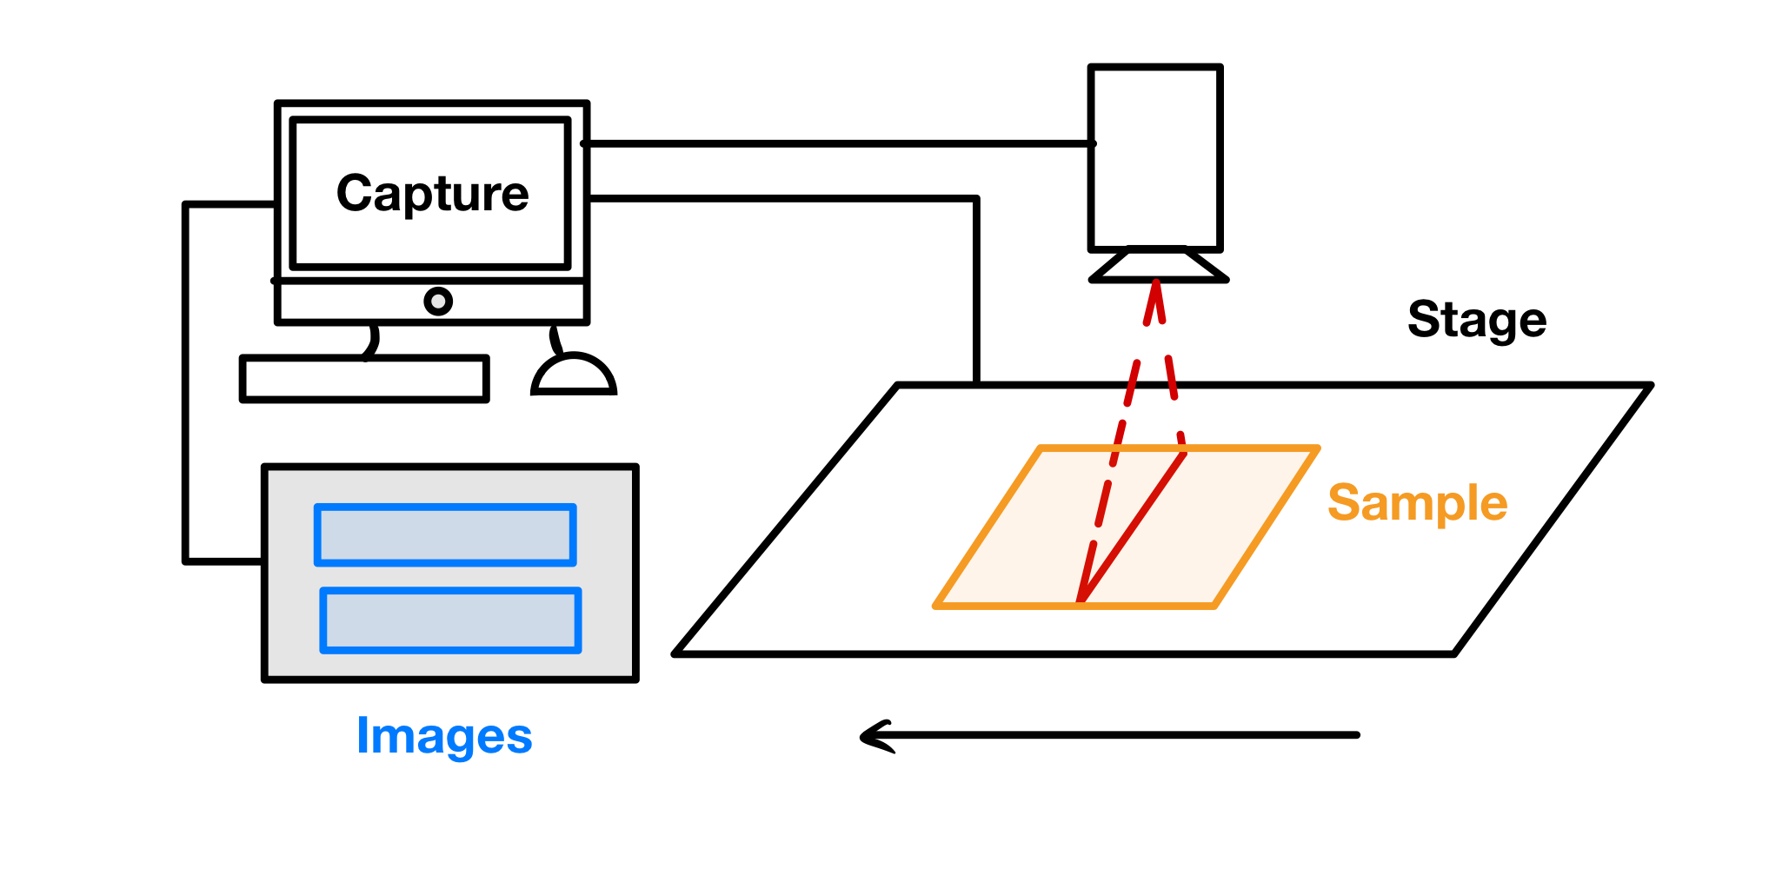
Notes:
Why does it need to move?
Important to note that the computer syncs the start of the image capture and the movement of the stage

Slide 35
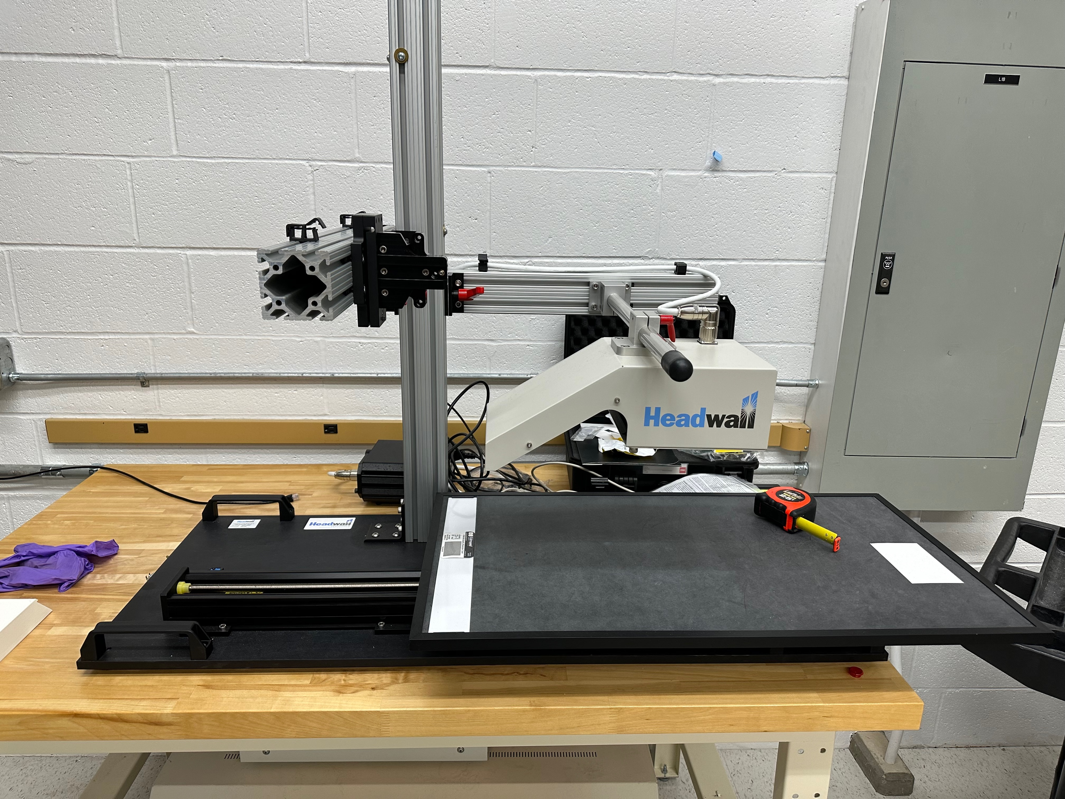

Slide 36
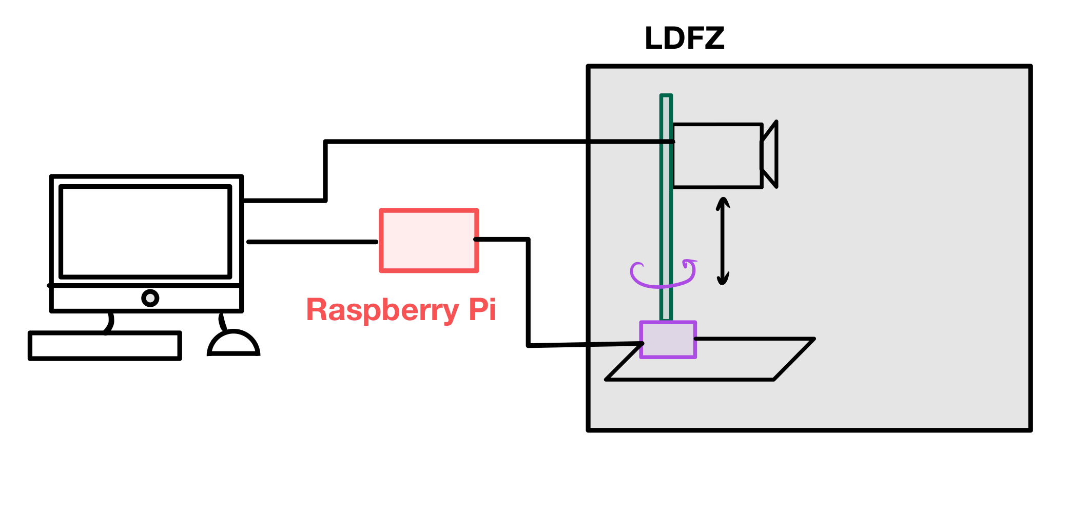
Notes:
How do we sync the motor with the image capture? We are replacing the stage with the motor

Slide 37
Extra Slides – Streaming

Slide 38
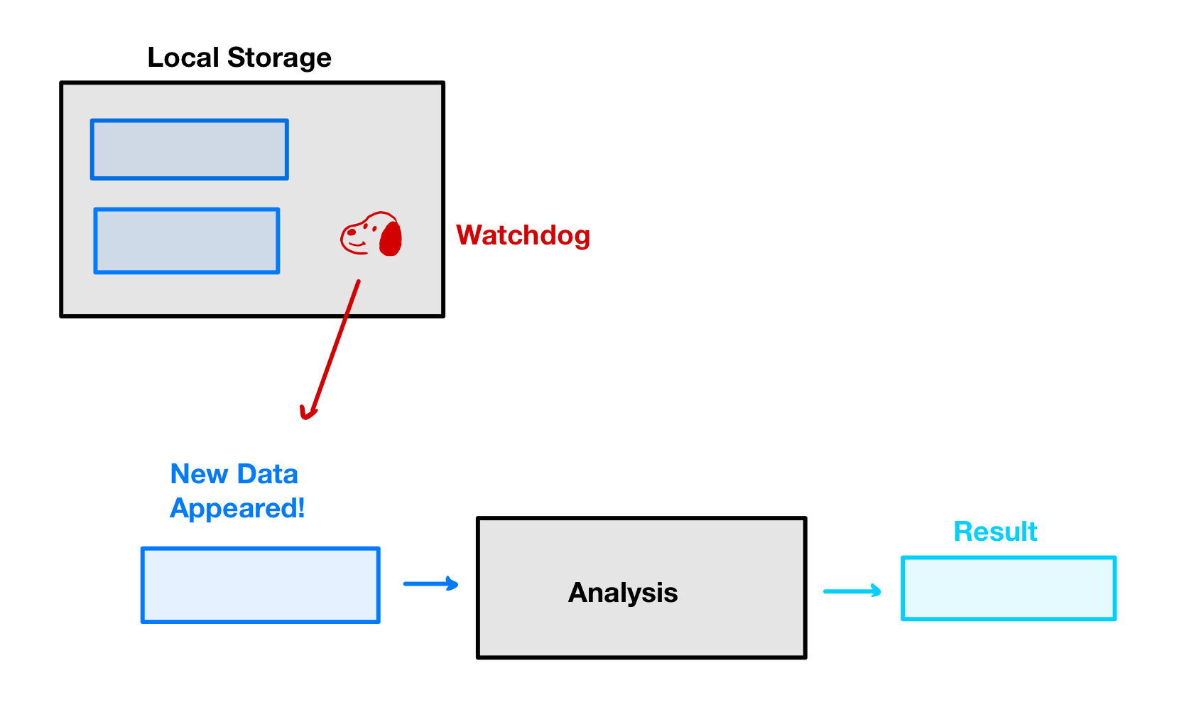

Slide 39
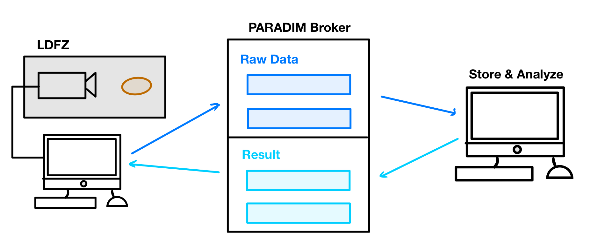
Notes:
Animate in one piece at a time

Slide 40
